Slide 1
Sanitary Engineering
Water supply Engineering
By
Dr. Muhanad M. Abbas

Slide 2
TODAY TOPICS
Treatment Of Water Supply
Filtration:
Filter Media.
Sand.
Gravel.
Colloidal Particals.
Coagolation.

Slide 3
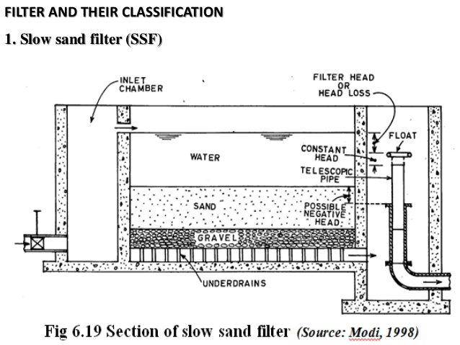

Slide 4
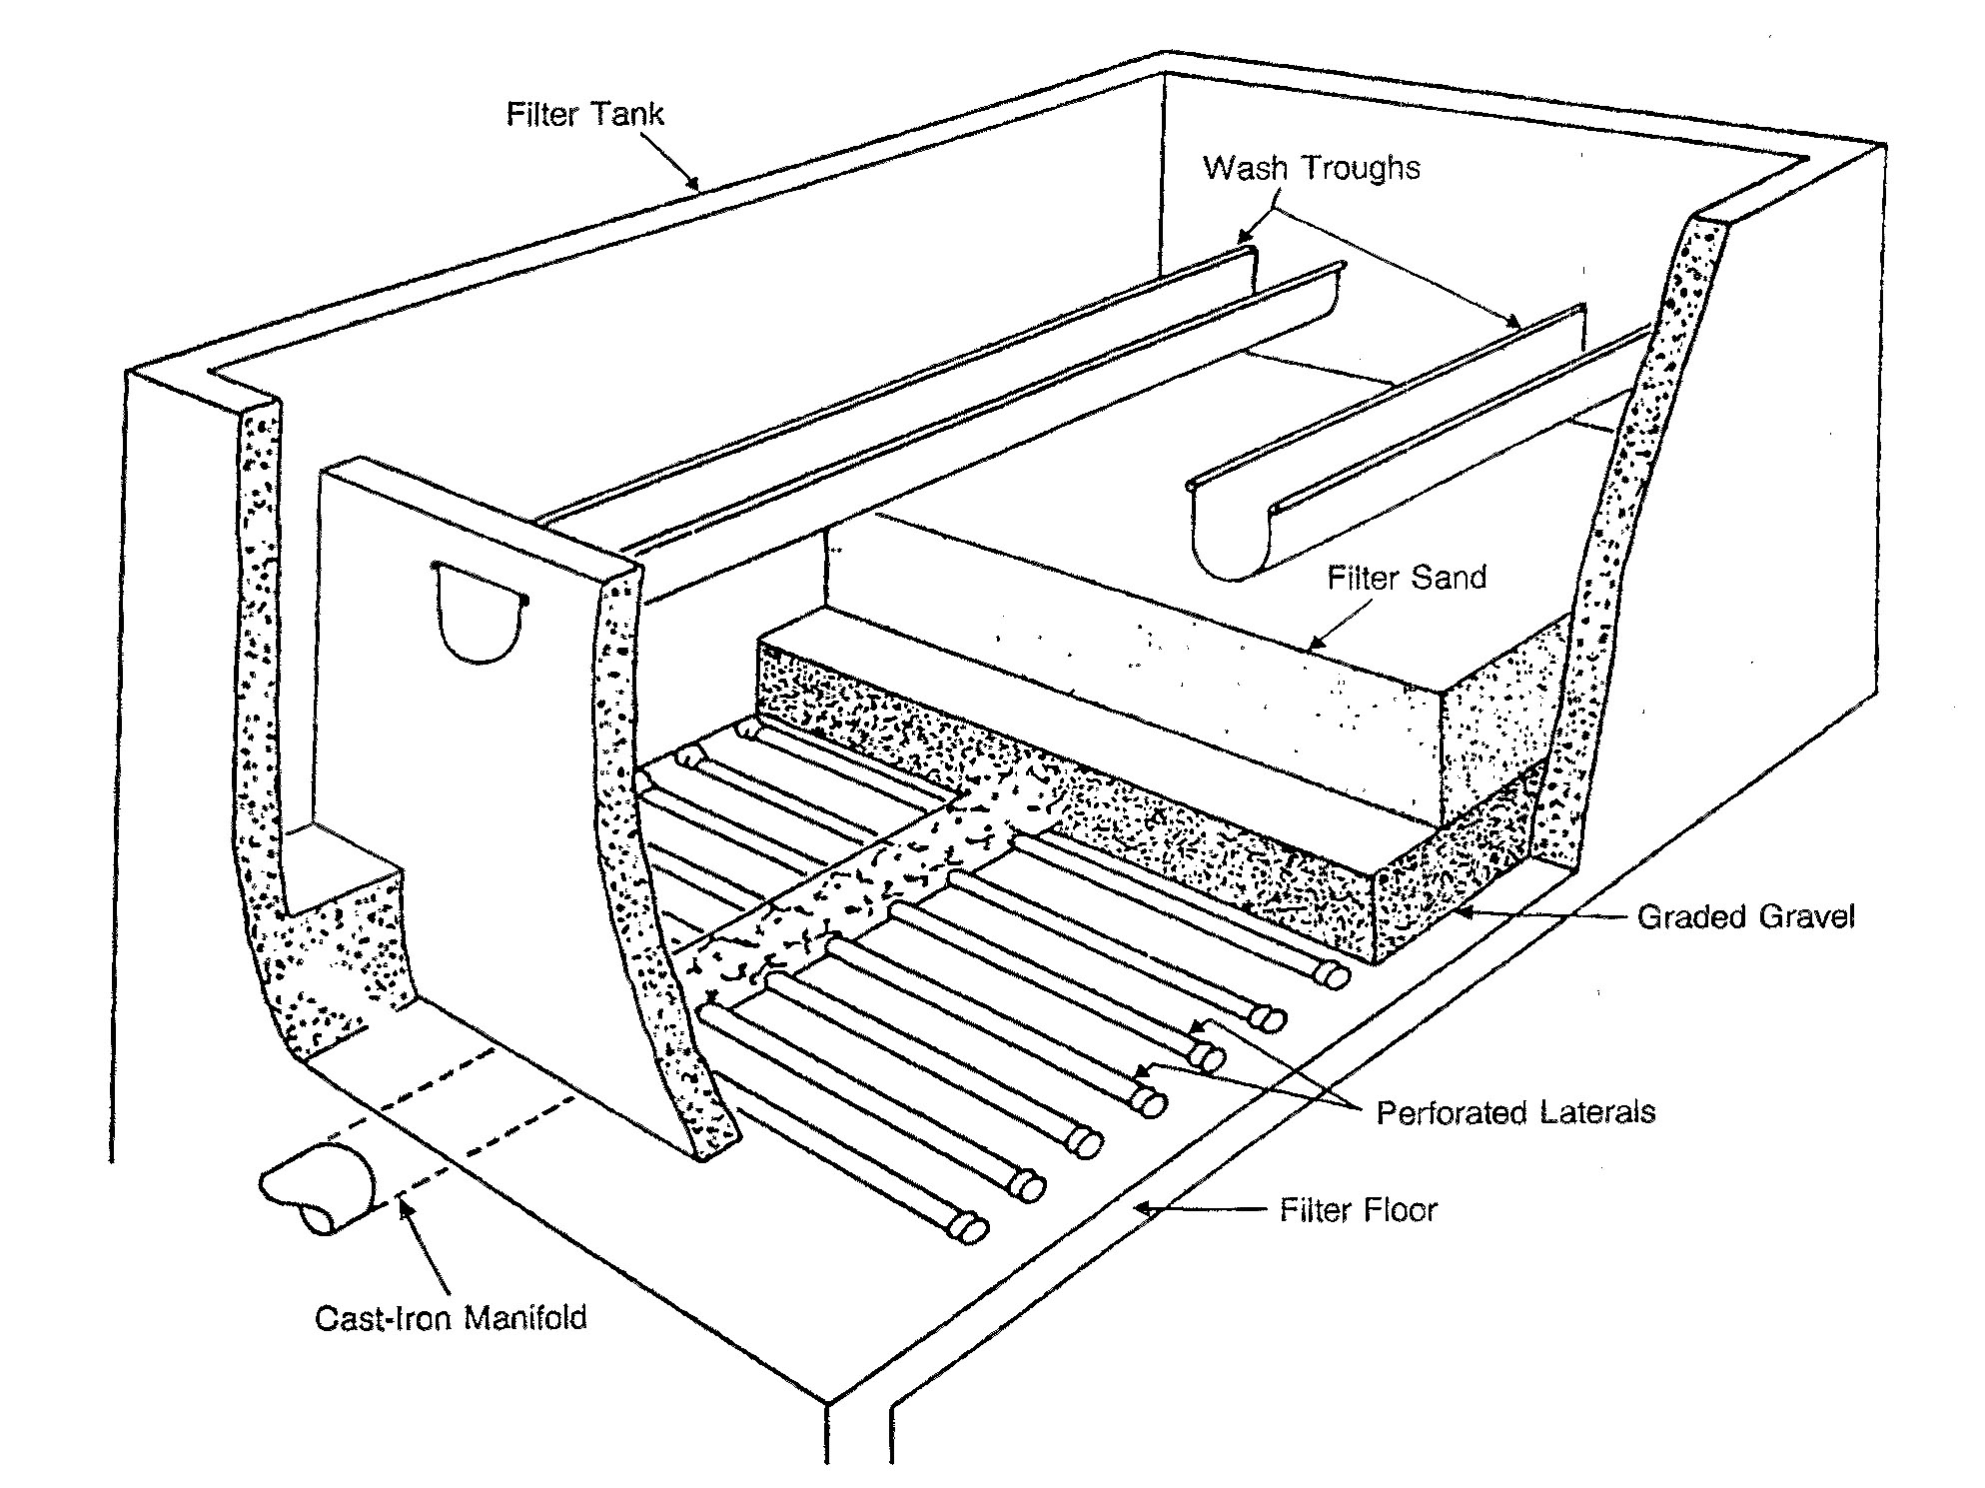

Slide 5
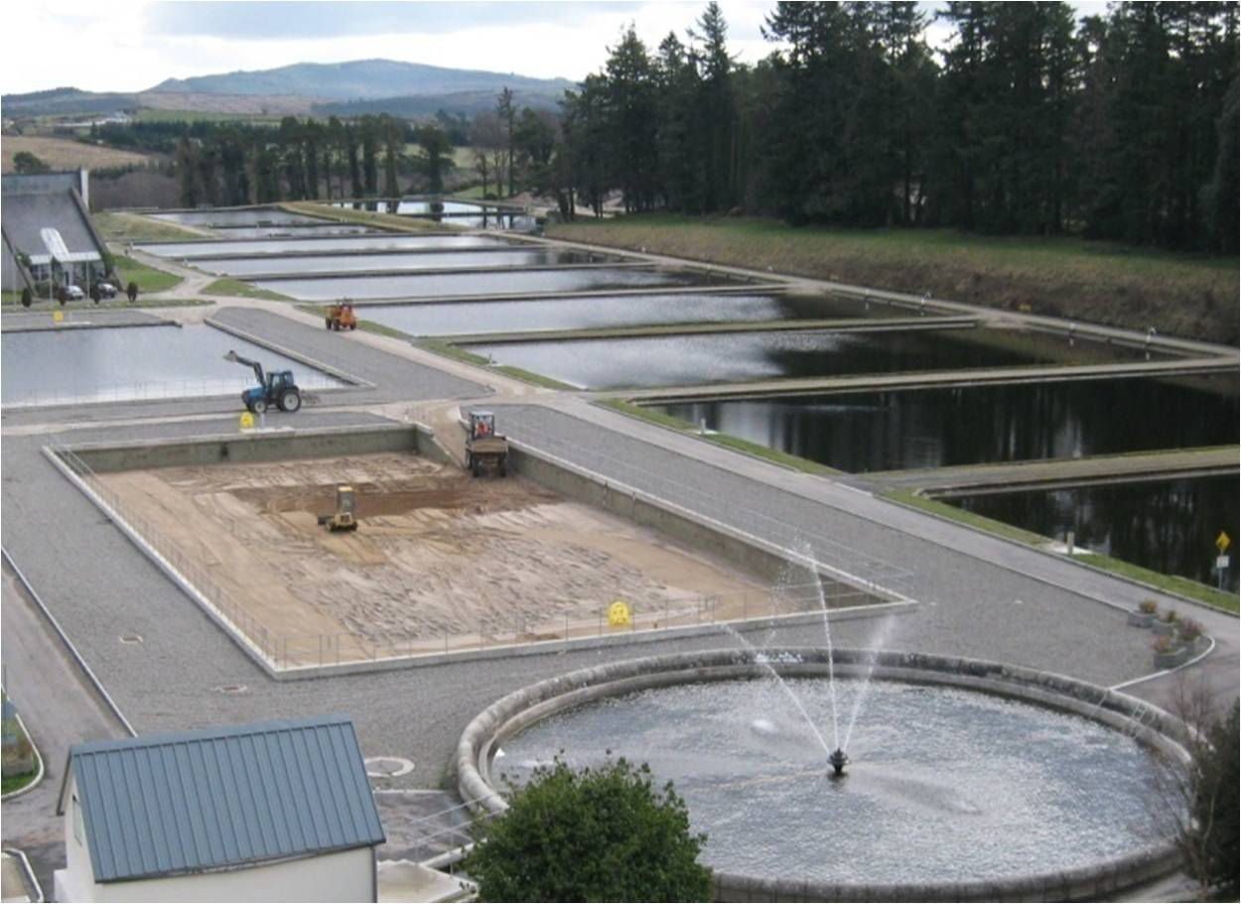

Slide 6
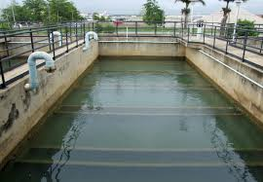

Slide 7
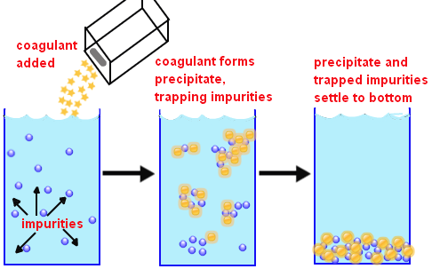
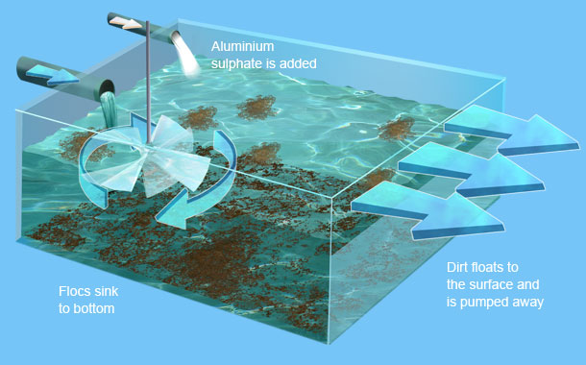

Slide 8
